Slide 1
Spring Rest Part 2

Slide 2
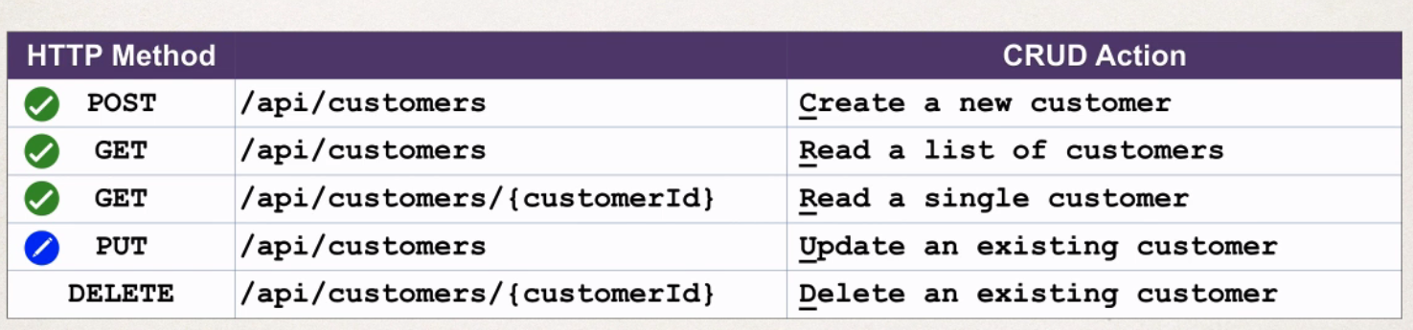
Update a Customer
Now we are making a put request to the RestController, for Updating an existing customer.
Here while making a put request we have to pass the id, then only it is possible to update, other wise it will create another customer with the same existing details.

Slide 3
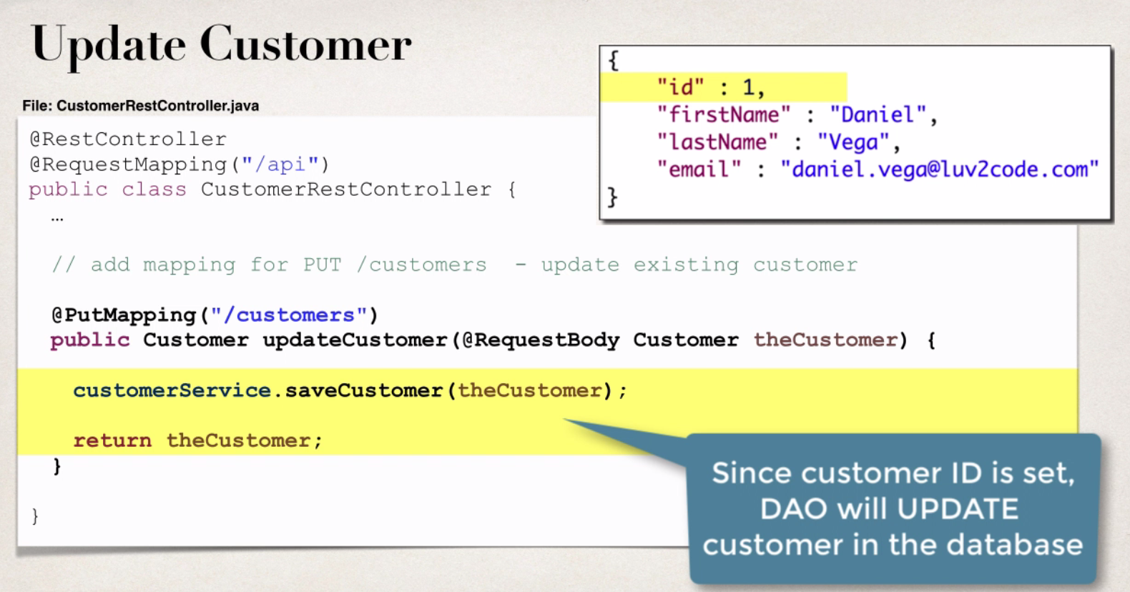
In the controller method we need add support for put mapping, here no need to set the id to 0 , as we are updating the existing customer.
That’s all about the code for updating a customer, open the post man, choose post method, add the data as shown in above slide in request Body

Slide 4
If we write saveCustomer() the customer, without returning theCustomer then the customer will be updated but we can’t see the response in the request body.
To check we have to open the data base and verify it. So don’t forget to return theCustomer. So once user details were updated then we can see the updated user details as part of the request body.

Slide 5
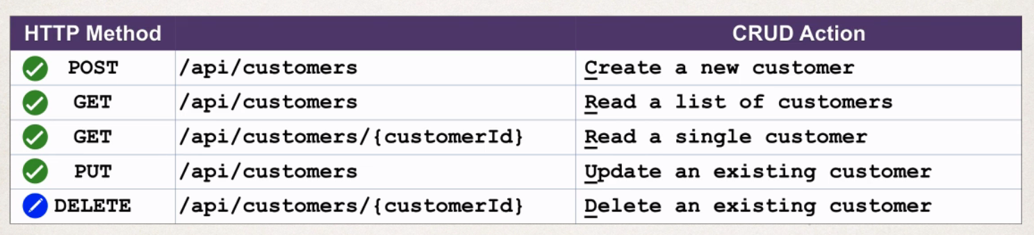
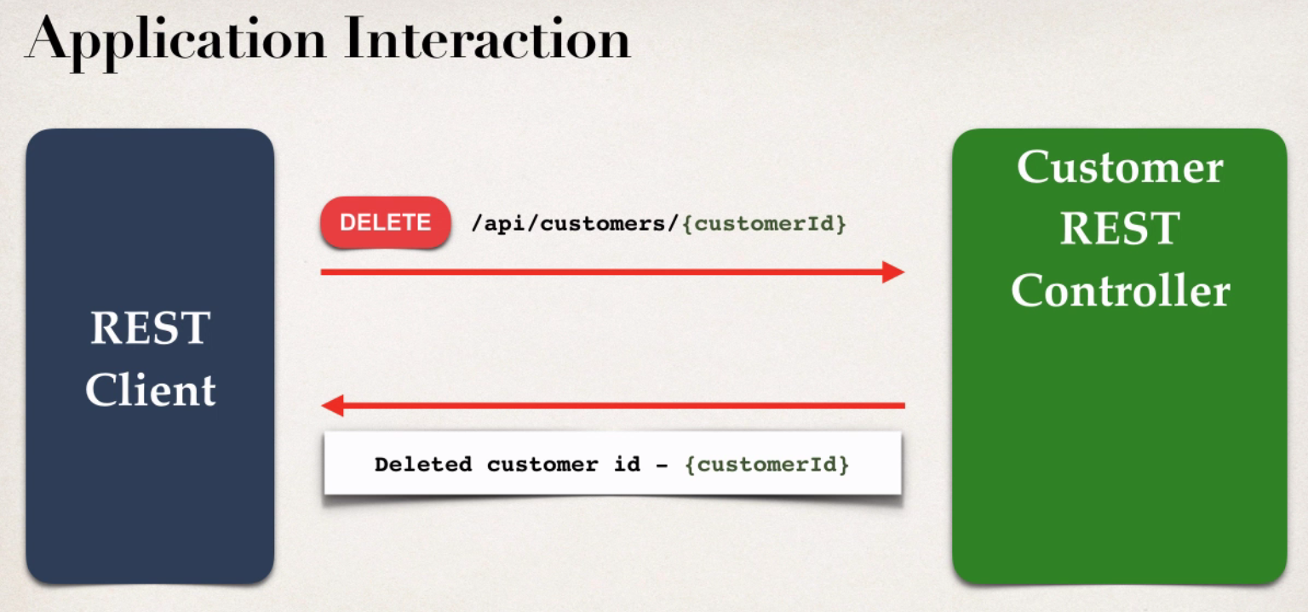
Delete a Customer
D

Slide 6
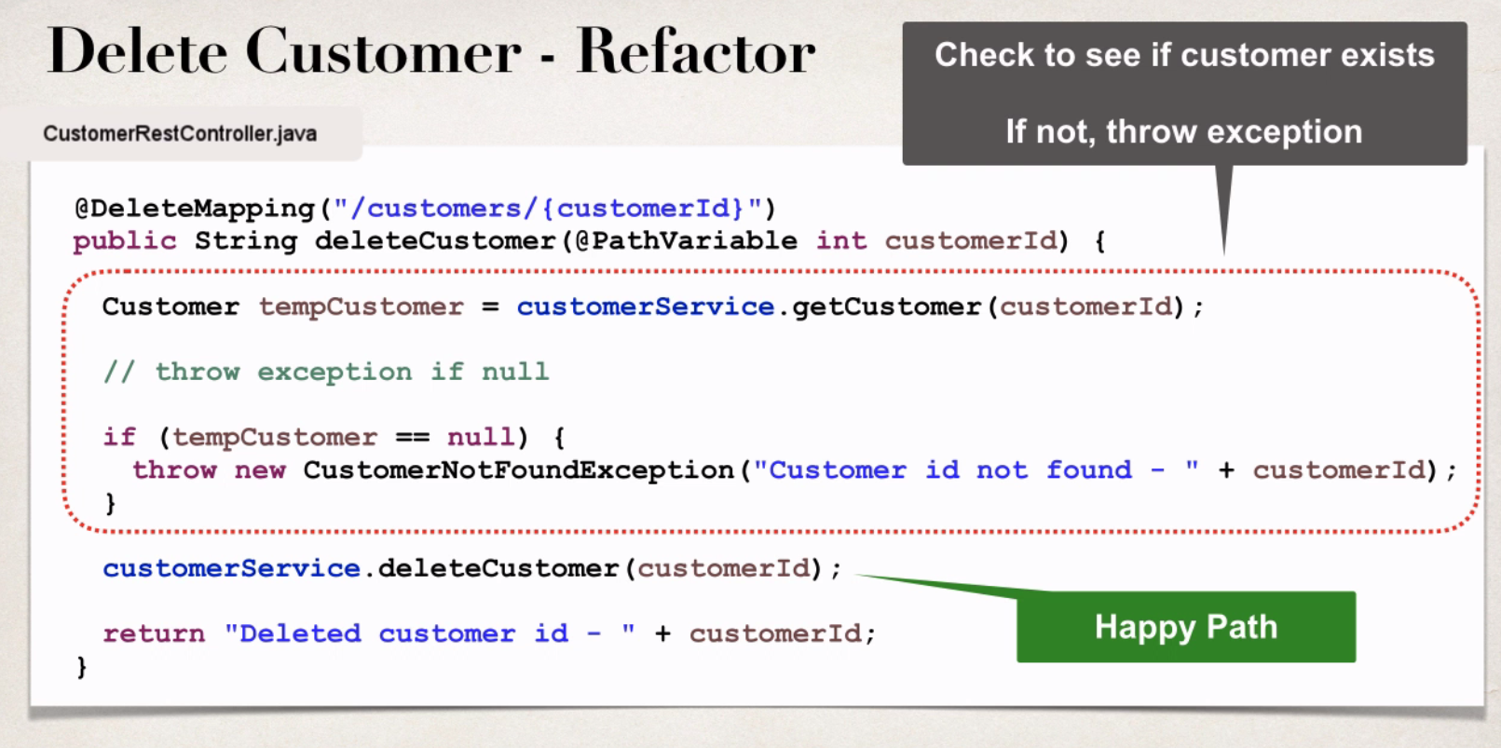
Support for delete mapping

Slide 7
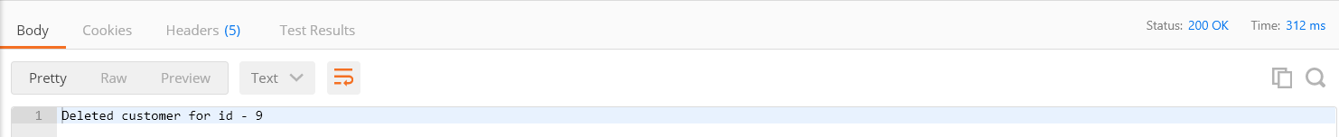
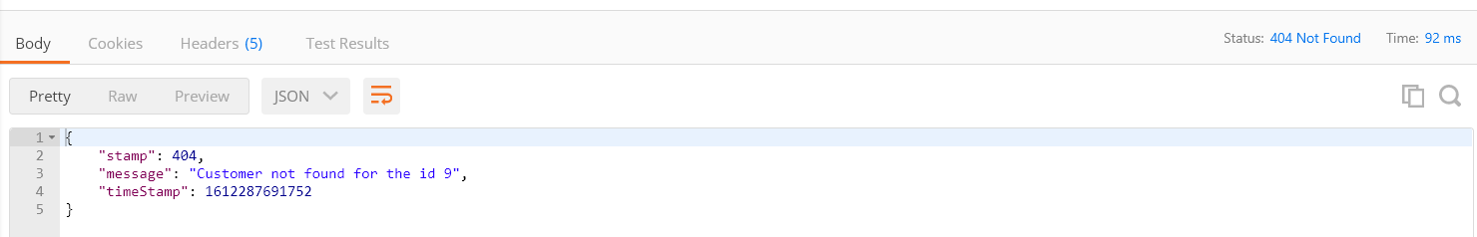
In the first slide here, we can see the response body when customer successfully deleted.
In the second slide if we try to delete a customer whose id is not available in the data base we are getting customer not found exception.
Everything is working as desired.
Whit this we have done get, update, put, delete a customer through our rest api.

